Slide 1

Class : 6
SAS Tutorial
Presented By : Shashi Kumar

Slide 2
Descriptive Statistics : Proc Freq
Proc freq data= input data <option>;
Table var1 var2 …..varn;
Run;
The freq procedure produces one way to n-way frequency tables.
The table statement specifies the frequency table and cross tabulation to produce.
* between variable request n-way cross tabulation tables.
One way frequency tables produces freq, cumulative freq, percentage,Cummulative percentage.
N-way freq table produces frequency,row%,column %,Total %
Note:- Without the table statement Proc freq produces the frequency table for each variable (Character & Numeric).
Option can be Placed in table statement after a / to suppressed the display of default statistics.
Nocum
NoPercent
NoFreq
Norow
Nocol
Options to be added in table statement after the / to control the dataset.
Outcome : Include the cumulative freq and cumulative percentage in output data set.
Outpct : Include the column% and row % in the output dataset.

Slide 3
Descriptive Statistics : Proc means
Proc Means data = input data <option>;
Var analysis variable;
Class Classification Variable;
Run;
It provides data summarization tools to compute descriptive statistics for variables across all observation and with group of observation.
The means procedure produces summary report that display descriptive statistics.
The var statement specifies the analysis variable and their order in the result.
The class statement identifies the variables whose value is defined subgroups for the analysis.
By default the means procedure create the report with N, mean, Standard deviation, Minimum, Maximum.
Note: Without the Var statement proc means analysis all numeric variables in the data set.

Slide 4
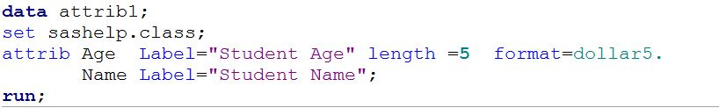
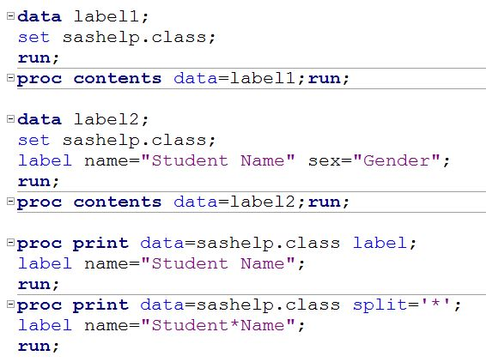
Length/Label/Attrib Statement
1. Length var<$> length;
length name $ 5;
Length age 3;
Length statement defines length of the variables.
Length of character variable must be define before the variable created at PDV.
3. Attrib variable-list attribute-list ;
Associates a format, informat, label, and length with one or more variables.
2. Label var1= “label 1” var2= “label 2” … varn= “label n” ;
It assign the descriptive level to the variable name.
Any number of variables can be associated with single label statement;
A label can have 256 character;
Using a label statement in the data step, Permanently associate labels with variable by storing the label in the description portion of SAS data set.
Proc print Option:-
Label : By default proc print the variable name in the output window. If we need to print the label then we have to used label option in proc print statement.
Split: It is used to split the label in to multiple line.

Slide 5
First dot and last dot (By grouping Processing) :
The By statement in dataset enable SAS to process data in groups.
By statement data step create two temporary variable for each variable listed in the by statement.
The first variable has a value of 1 for the first observation in the by group, otherwise it equal to 0.
The last variable has a value of 1 for the last observation in the by group otherwise it is 0.

Slide 6
Thank You …

